Slide 1
The Evolution of Analytics and the US Presidential Elections
2004-2012

Slide 2
US Presidential Election Background
Each state is worth a number of votes proportional to its population
Winner of a state (usually) takes all
US Presidential Elections are a good barometer of the state of data mining because
Campaigns have lots of money to invest
There is a lot of data on voters
They occur every four years to give period updates
Margin is close enough for analytics to matter
Predictive Analytics used to raise money, target voters, deploy resources, and win elections
The more analytical campaign won the three elections

Slide 3
US Presidential Elections 2004-2012
2004 – George W. Bush re-elected
Karl Rove “The Architect”
Targeted voters with benchmarks, data to segment voters and statistical experiments
2008 - Barack Obama wins
Social Media used to target voters
Accumulated a lot of data on voters
Data was not consolidated for maximum analytical use
2012 – Barack Obama re-elected
Over four years the data was “connected” for analytical use
Huge team of data miners
Predictive analytics used to target voters more efficiently and effectively

Slide 4
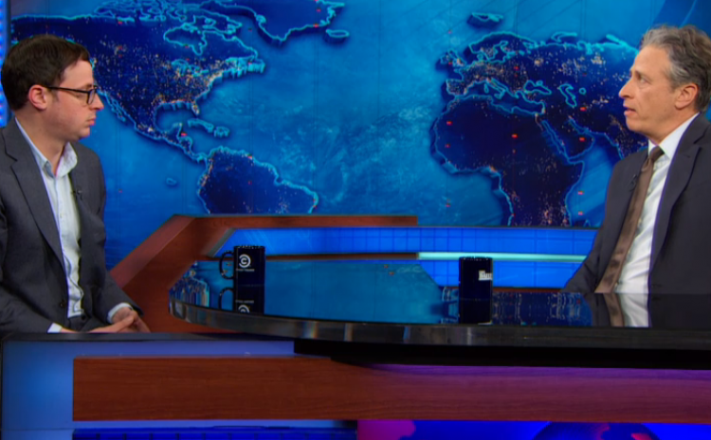
US Presidential Election - 2012
Nate Silver: An analytics star is born

Slide 5
What lessons can be learned?
The plight of Karl Rove in 2012
Stay current on current technology
Get good data
Don’t allow your bias to cloud your decision-making
When are analytics most effective?
Champion needed
Proper funding
Application to an actionable problem
Question: Do you think analytics had a role in these elections?
What if the margin of victory were 10%?

Slide 6
What’s next?
Republicans have recognized the gap in analytics from 2012
They are trying to close it
http://www.datanami.com/2014/11/04/data-analytics-shaped-election-day-2014/
Republicans did well in the 2014 mid-term elections taking the Senate and increasing their margin in the house while winning most gubernatorial races
Stay tuned for 2016!

